Slide 1

Limitations of Selenium IDE

Slide 2
Test Suite Creation
Test suite is a collection if multiple test cases.
Selenium IDE allows the user to run multiple test at one go.
To Run the test Suite click on the “Play entire test suite” button

Slide 3
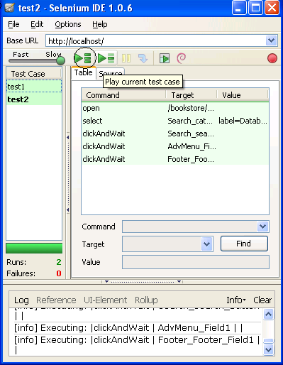
Running a Suite
Test Suite with
Test1 & test2

Slide 4
Drawbacks of Selenium IDE
Runs only on firefox
Loops, conditional statements can not be applied
Can not handle dynamic content like dynamic tables
Doesn't support error handling
Selenium IDE do not support Database testing

Slide 5
Drawback Real Time Example
Can’t perform regression testing by using Selenium IDE
Example:
Record few scenarios & execute those scenarios on multiple builds.
If the application is dynamically changing then we can’t perform the regression testing.
We can’t perform retesting.

Slide 6
Comparative Study
Selenium IDE | Selenium RC | Selenium WebDriver
It only works in Mozilla browser. | It supports with all browsers like Firefox, IE, Chrome, Safari, Opera etc. | It supports with all browsers like Firefox, IE, Chrome, Safari, Opera etc.
It supports Record and playback | It doesn’t supports Record and playback | It doesn’t supports Record and playback
Doesn’t required to start server before executing the test script. | Required to start server before executing the test script. | Doesn’t required to start server before executing the test script.
It is a GUI Plug-in | It is standalone java program which allow you to run Html test suites. | It actual core API which has binding in a range of languages.
Core engine is Javascript based | Core engine is Javascript based | Interacts natively with browser application
Very simple to use as it is record & playback. | It is easy and small API | As compared to RC, it is bit complex and large API.
It is not object oriented | API’s are less Object oriented | API’s are entirely Object oriented
It doesn’t supports of moving mouse cursors. | It doesn’t supports of moving mouse cursors. | It supports of moving mouse cursors.
Need to append full xpath with ‘xpath=\\’ syntax | Need to append full xpath with ‘xpath=\\’ syntax | No need to append full xpath with ‘xpath=\\’ syntax
It does not supports listeners | It does not supports listeners | It supports the implementation of listeners
It does not support to test iphone/Android applications | It does not support to test iphone/Android applications | It support to test iphone/Android applications

Slide 7
Thanks

